Slide 1
Mid-Day Meal Scheme
Chandigarh Administration
PAB Meeting 06.05.2019

Slide 2
Schools Covered Under MDMS
No. of schools Enrolment 2018-19
Primary U. Primary
Govt. : 113 50608 40782
Govt. Aided : 06 1791 1630
Madarasa : 04 351 172
Total : 52750 42584
Grand Total : 95334

Slide 3
Weekly MDM Menu/Cooking Cost
 | Prantha Based From AIHM-42 | Veg. Pulao Based From CITCO-17 | Veg. Pulao Based From CIHM-42
Monday | Prantha + Rajmah | Veg. Pulao + Dal Chana | Veg. Pulao +Dal Arhar
Tuesday | Prantha+ Karhi Pakora | Veg. Pulao + Karhi with veg. Pakora | Veg. Pulao + Karhi Pakora
Wednesday | Prantha+Dal Chana+ Veg. | Veg. Pulao + Dal Chana | Veg. Dalia
Thursday | Prantha + Rajmah | Veg. Pulao + Rajmah | Veg. Pulao + Rajmah
Friday | Prantha+ Karhi Pakora | Veg. Pulao + Karhi with veg. Pakora | Veg. Pulao + Karhi Pakora
Saturday | Prantha + Mix Dal | Veg. Pulao + Rajmah | Veg. Pulao + Nutri Aalo Mattar
Per Meal Rate | Rs. 8.94 (Both for Primary & U. Primary) | Rs. 7.20 for Primary Rs. 9.17 for U. Primary | Rs. 7.20 and Rs.0.61 additional for Nutri (1 Day) for Primary Rs. 9.17 and Rs.0.72 additional for Nutri (1 Day) for U. Primary

Slide 4
Per Meal Cooking Cost 2018-19
Fixed by GOI | Centre Share (100% as per norms) | Actual Avg. Per Meal Cooking Cost | Additional Support from State Budget (Col 3-2)
1 | 2 | 3 | 4
Rs. 4.35 (Pry.) Rs. 6.51 (U. Pry.) | Rs. 4.35 (Pry.) Rs. 6.51 (U. Pry.) | Rs 7.57* (Pry.) Rs. 9.73* (U. Pry.) | Rs. 3.22 (Pry.) Rs. 3.22 (U. Pry.)
* Includes Cost of Vegetables, Oils and Fats, Salt and Condiments, Fuel and labour & others overhead charges claimed by centralized institute excluding the cost of food-grains.

Slide 5
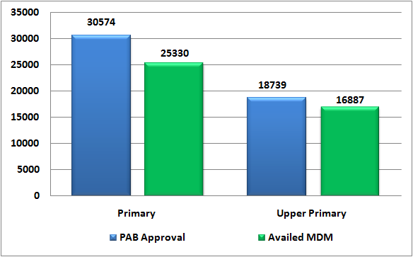
Coverage of Children
During the year 2018-19
Institutions | PAB Approval | Availed MDM | % Coverage | Proposed 2019-20
Primary | 30574 | 25330 | 83 | 27000
Upper Primary | 18739 | 16887 | 90 | 18000
Total | 49313 | 42217 | 86 | 45000

Slide 6
Budget Utilization
During the year 2018-19
(In Lakh)
Total Budget Allocation | Centre Share (100% as per Norms) | UT Provision (Addl) | Utilization 2018-19 | % Utilization
1500.29 | 791.65 | 706.67 | 1359.40 | 90.61

Slide 7
Component wise Budget Utilization
(In Lakh)
Component | Allocation 2018-19 |  |  | Utilization 2018-19 |  | % Utilization
 | Centre Share | UT Share | UT Provision (Addl) | Centre | UT | Centre | UT Share
Cost of Food-grains | 37.83 | 0 | 0 | 18.71 | 0 | 49.46 | 0
Cooking cost | 632.37 | 0 | 445.77 | 521.68 | 445.77 | 82.50 | 100.00
Honorarium of CCH | 82.50 | 0 | 155.78 | 79.61 | 155.78 | 96.50 | 100.00
Transportation Assistance | 10.92 | 0 | 50.03 | 4.46 | 50.03 | 40.84 | 100.00
Monitoring Management, and Evaluation (MME) | 30.00 | 0 | 55.09 | 28.27 | 55.09 | 94.23 | 100.00
Total | 793.62 | 0 | 706.67 | 652.73 | 706.67 | 82.25 | 100.00

Slide 8
Payment of Bills of Food Grains to FCI
During the year 2018-19 (Figures in Lakh)
Food Grains for Both Primary & U. Primary | Central Assistance Allocated | Central Assistance Released | Bills Raised by FCI | Payment to FCI | Outstanding
Rice & Wheat | 36.31 | 36.31 | 18.71 | 18.71 | Nil

Slide 9
Data Entry Status under MDM-MIS Portal
&
Status of Automated Monitoring System
Annual Data Entry : 100 %
Monthly Data Entry : 100 %
Health Data Entry : 100 %
SMS based Automated Monitoring System (AMS) has been implemented successfully in UT Chandigarh through NIC Chandigarh (Adopted the Model of NIC HP)

Slide 10
Coverage under RBSK (School Health Programme) During the year 2018-19
Components | No. of Children Covered
Health Checkup (Recording of Height & Weight etc.) | 132315
Coverage under WIFS (Distribution of IFA & De-worming medicine) | 113290
Spectacles Distributed | Nil*
Number of visits made by RBSK team - 1670
*As reported by Nodal Officer RBSK, Spectacles were not distributed to children with refractive error due to insufficient fund with Health Department.

Slide 11
Proposed Budget 2019-20
(Figures in Lakh)
 | Centre Share (100% as per norms) | UT Provision (Additional) | Total
Primary | 378.95 | 746.05 | 1125.00
U. Primary | 324.82 | 453.95 | 778.77
Total | 703.77 | 1200.00 | 1903.77

Slide 12
Component wise Proposed Budget 2019-20
(Figures in Lakh)
Component | Centre Share |  |  | UT Provision
 | Primary | Upper Primary | Total | Primary | Upper Primary | Total
Cost of Food Grain | 16.15 | 16.15 | 32.30 | - | - | -
Cooking Cost | 270.14 | 269.51 | 539.65 | 199.96 | 133.31 | 333.27
Transportation Assistance | 4.66 | 4.66 | 9.32 | 45.00 | 30.00 | 75.00
Honorarium to Cook cum Helpers | 48.00 | 34.50 | 82.50 | 96.00 | 69.00 | 165.00
Monitoring Management and Evaluation (MME) | 40.00 | 0.00 | 40.00 | 72.64 | 0.00 | 72.64
Additional Food Item (Milk, Egg & Banana) | 0.00 | 0.00 | 0.00 | 332.45 | 221.64 | 554.09*
Total | 378.95 | 324.82 | 703.77 | 746.05 | 3.95 | 1200.00
* The issue regarding revision of per meal cost of Centralized Cooking Institutes is under consideration. The Expenditure for this purpose shall be met out of from the saving under the component of Additional Food Item.

Slide 13
Components wise Proposed MME
Components | Amount in Lakh
Salary of Existing Manpower | 81.32
Transport & Conveyance | 4.32
Office Expenditure | 3.00
Purchase of required Furniture, Computer Hardware and Accessories | 2.00
Testing of cooked Food & Foodgrains samples of MDM | 4.00
Fortification of Foodgrains | 5.00
Expenditure on Automated Monitoring System | 2.00
School Level Expenses | 11.00
Total | 112.64

Slide 14
Best/Innovative Practices
School Cluster Kitchens have setup their kitchen gardens for fresh vegetables.
CCTV Cameras are installed in all MDM kitchens.
Honorarium to Cook-cum-helpers is paid Rs. 3000/- per month per CCH whereas norms of GOI is Rs. 1000/- per month per CCH.
Fortified Wheat Flour, Fortified Rice and Double Fortified Salt is used for preparation of MDM.
Compost is prepared from the Kitchen waste.
MDM is cooked by the professionals of Hotel Management Cooking Institutes.
Additional fund support by the Chandigarh Administration of Rs. 706.67 Lakh during the year 2018-19.

Slide 15
Cooking Process/Monitoring of MDM
Cooking process at Centralized Cooking Institutes starts very early in the morning.
The preparation of MDM in the centralized cooking institute is supervised by the retired personnel engaged as Inspectors/Supervisors.
The supervisory staff monitors the procedure with reference to quality, hygiene and other factors on daily basis.
The supervisory staff take delivery of cooked food from the cooking institutes and safely transport the meal upto the school, handover the hot cooked food to the MDM Teacher Incharge of each school.
Heads of Schools also monitor MDM on Daily Basis.
Monitoring of MDM is also carried out by PCS/HCS Officers and Senior Officers of Education Department.

Slide 16
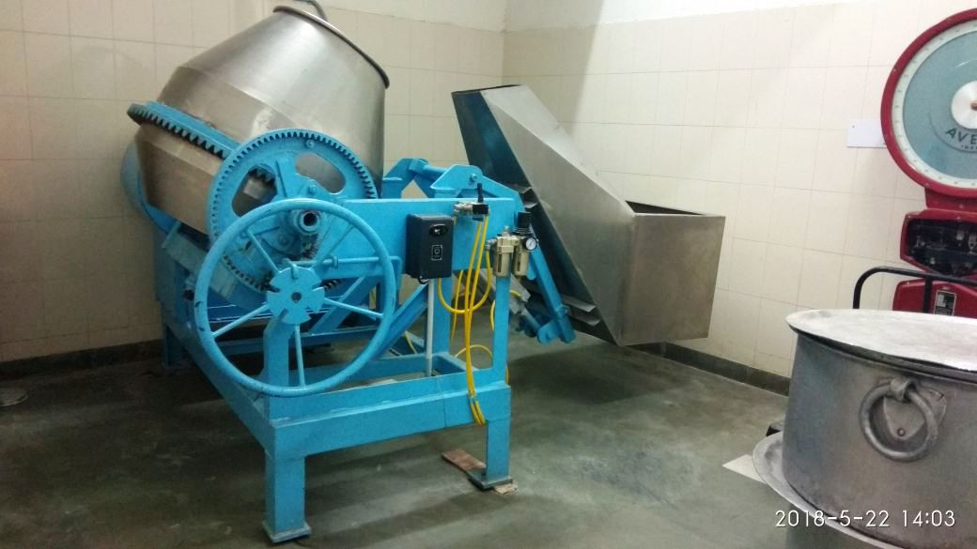
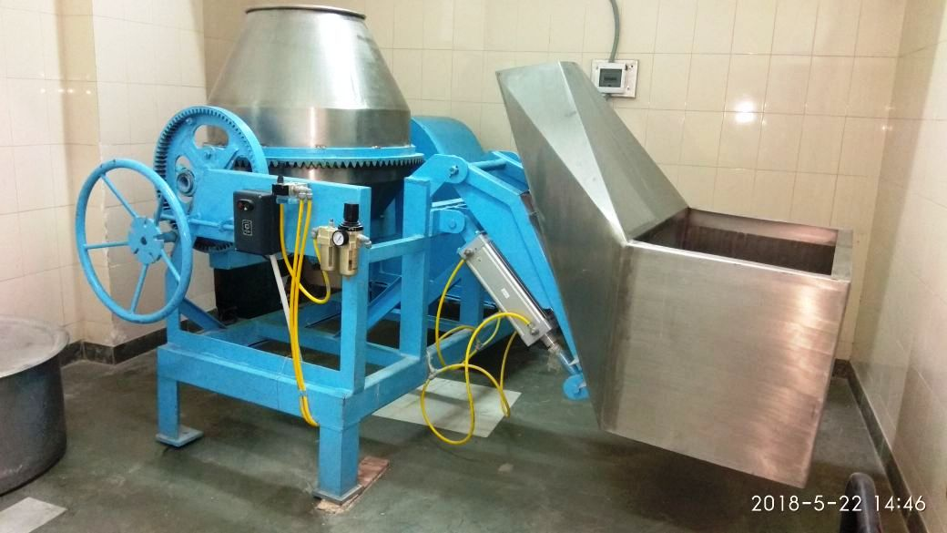
Mixture/Blender for Fortification of Rice
(Iron, Folic Acid & Vitamin B12)
Rice to be used for School Based Cluster Kitchens is fortified in the MDM store at GMHS-22 with the help of Blender provided by the NGO-PATH.
Centralized Cooking Institutes CIHM and CITCO are fortifying rice at their own level with the help of Blenders.

Slide 17
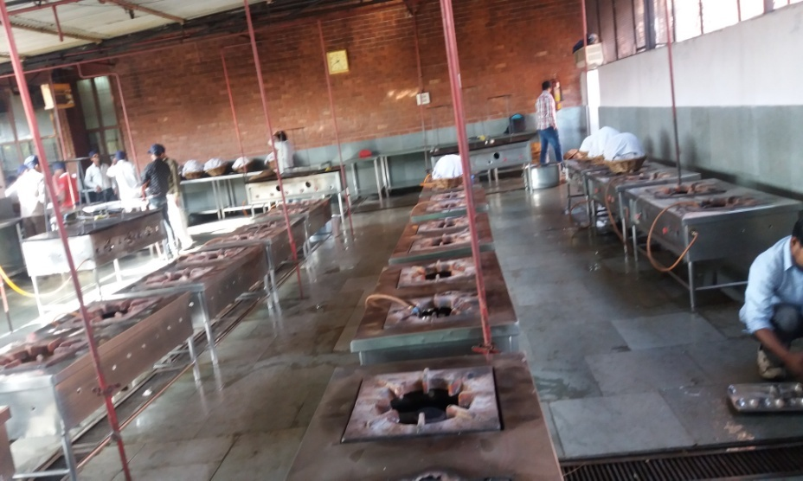
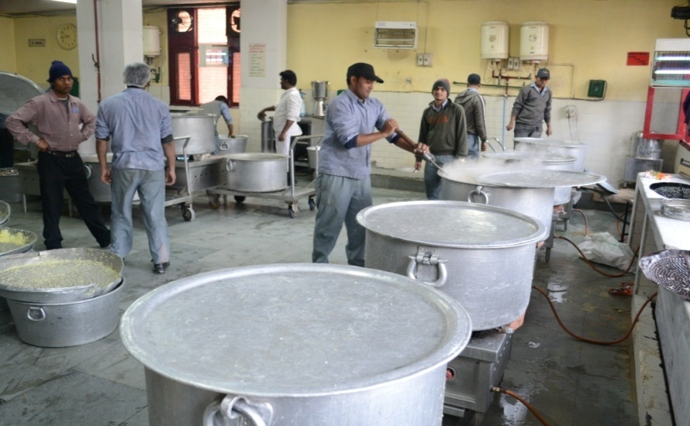
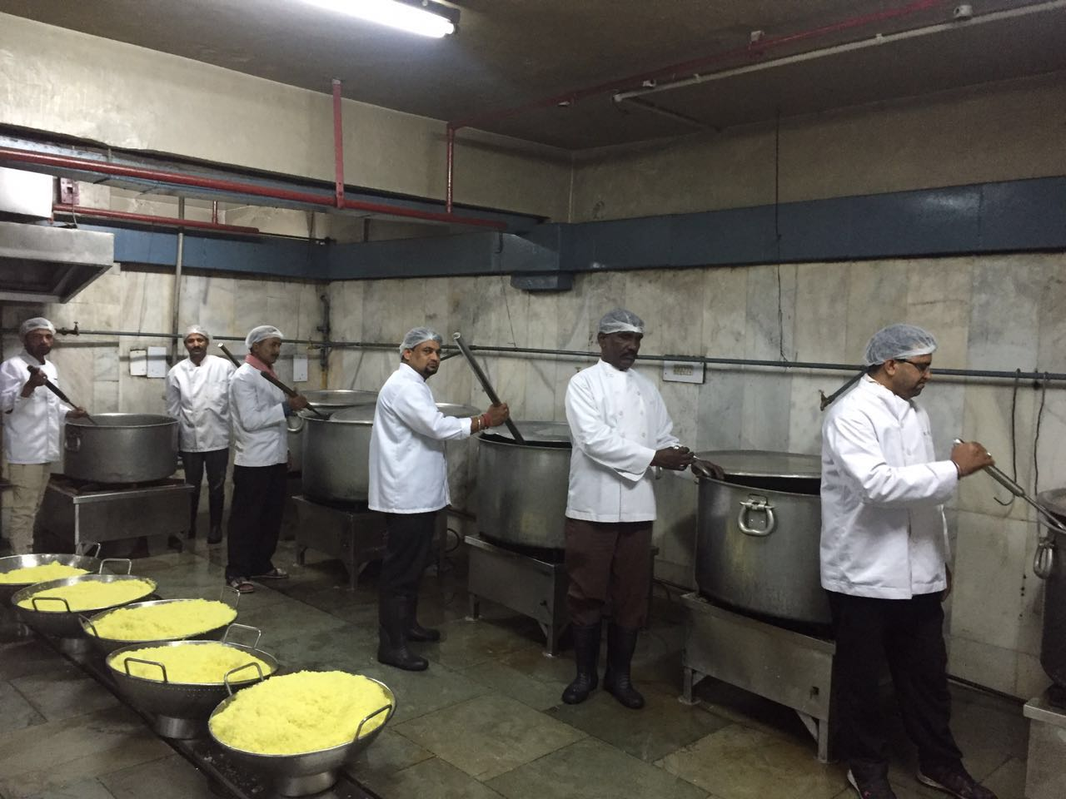
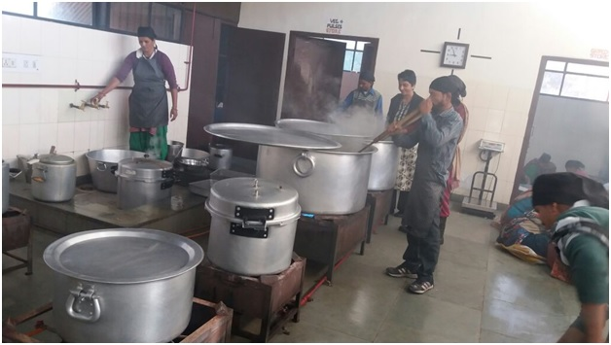
Centralized Kitchens at a Glance
AIHM-42 CIHM-42
CITCO-17 School Based Kitchen -GMSSS-47

Slide 18
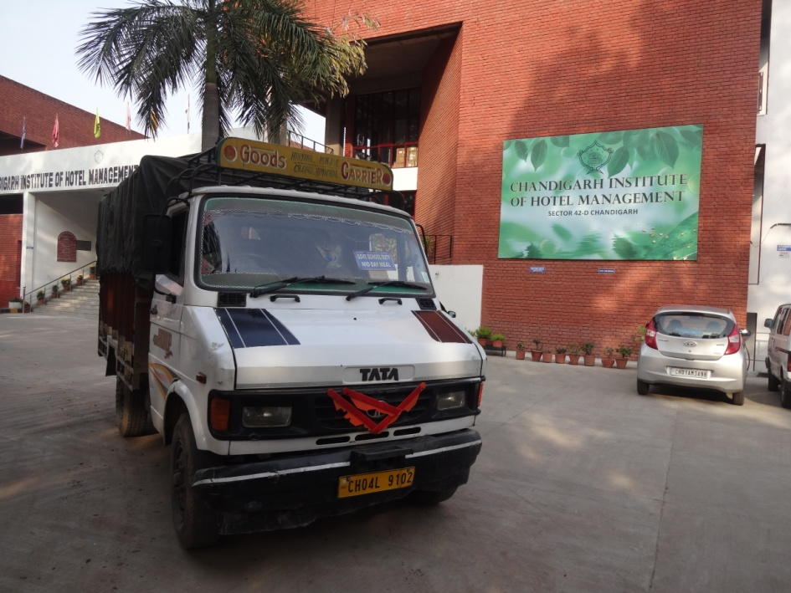
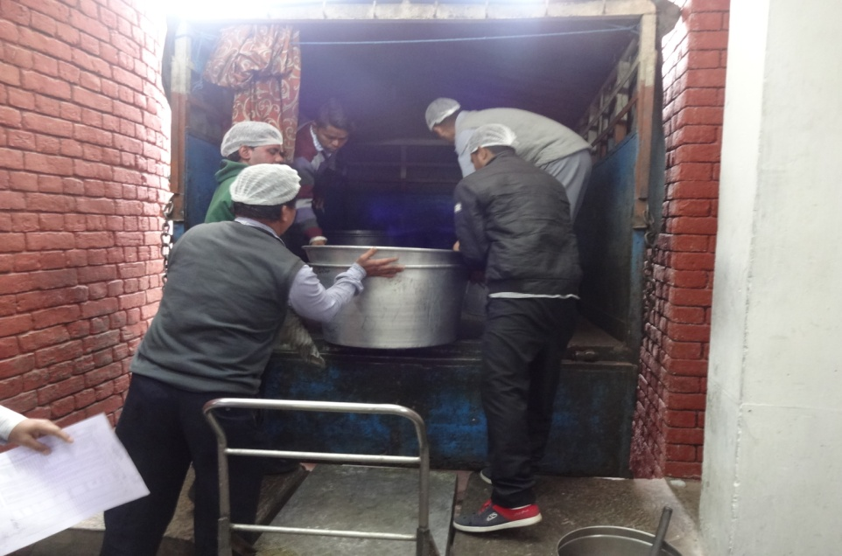
Transportation Arrangements
Food grains are transported by Big Trucks from FCI Godown to MDM stores and from stores to cooking sites by Mini trucks.
Cooked meals are transported to schools by mini trucks.

Slide 19
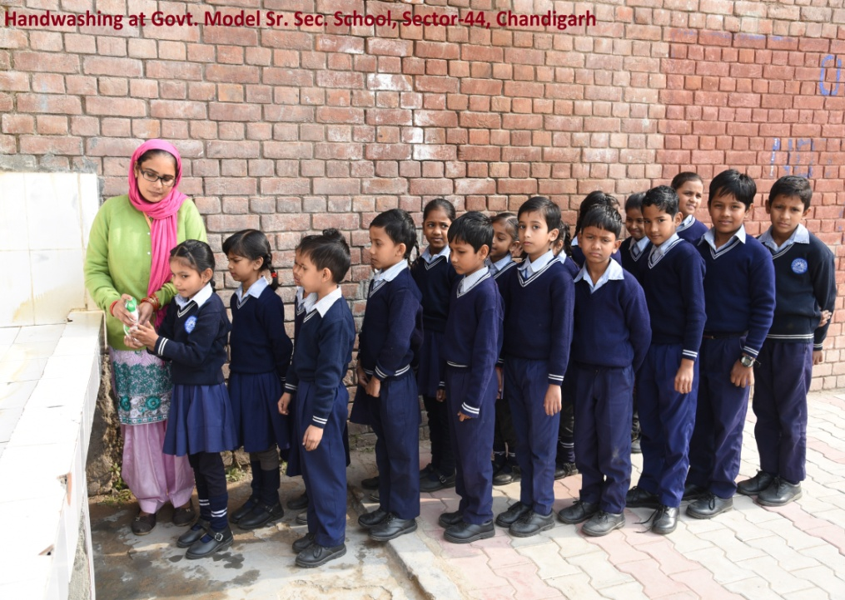
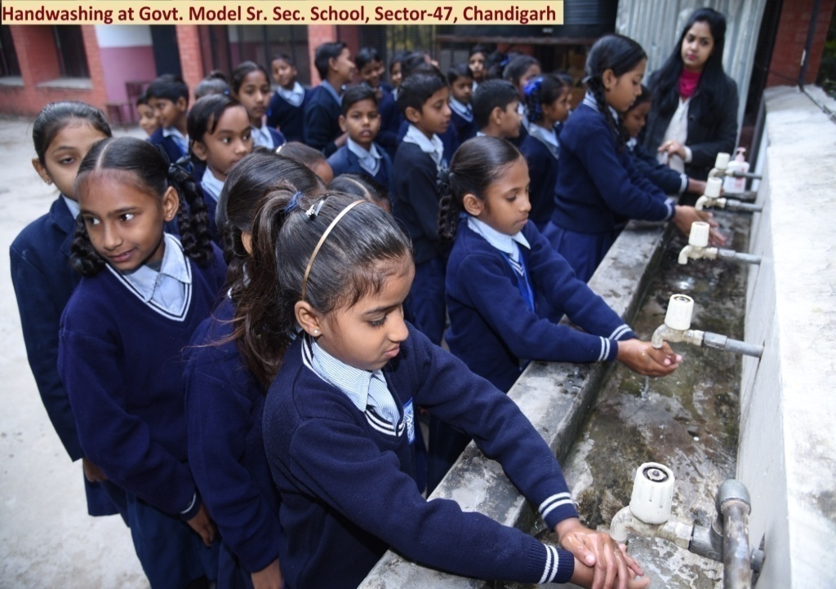
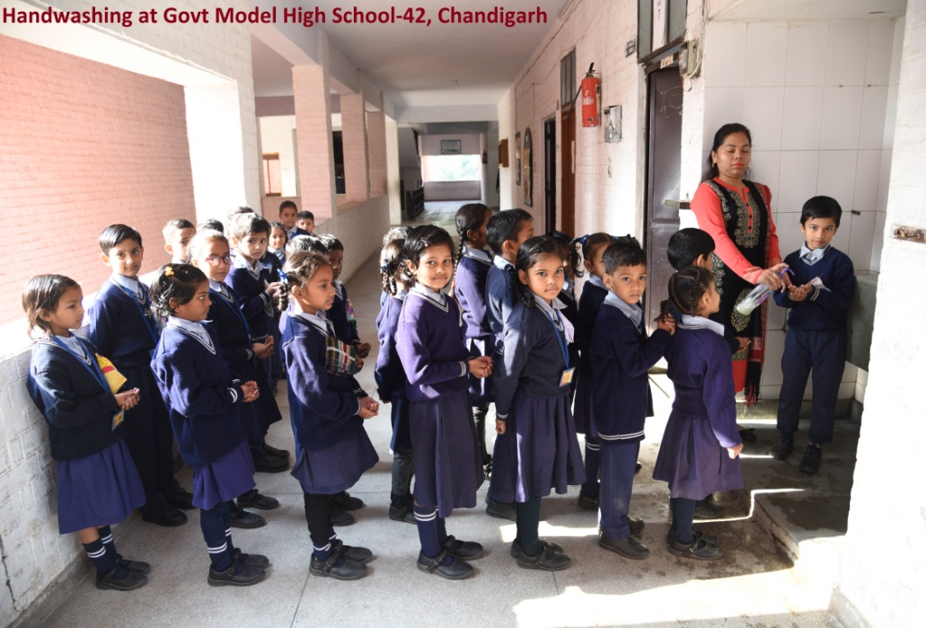
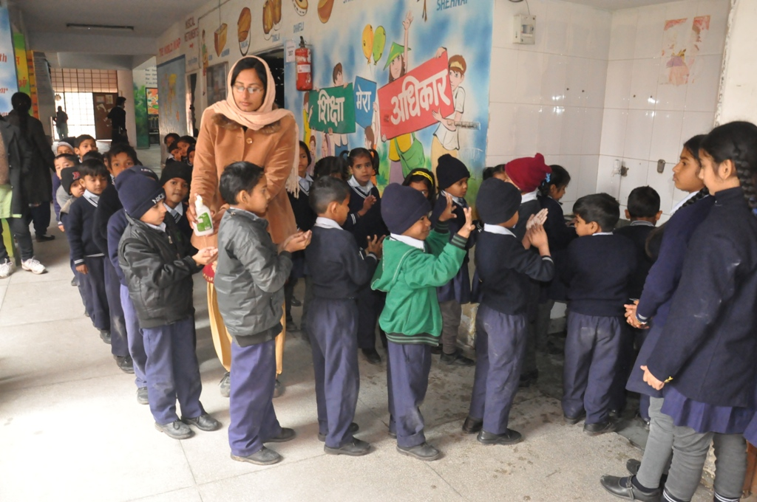
Hand Washing

Slide 20
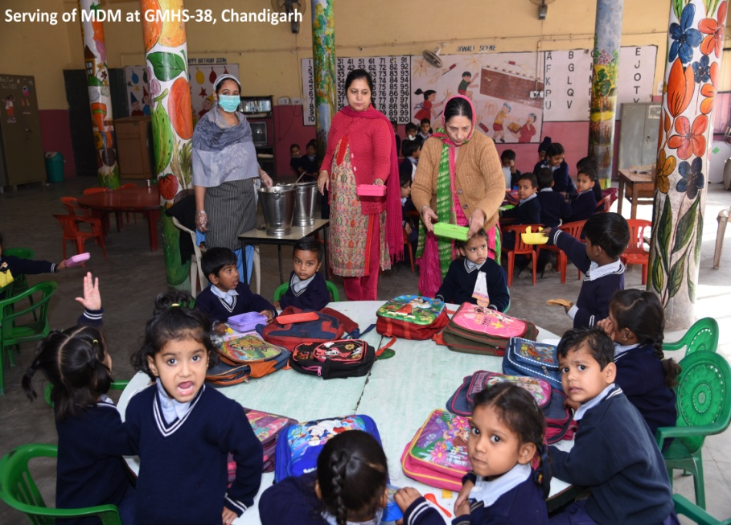
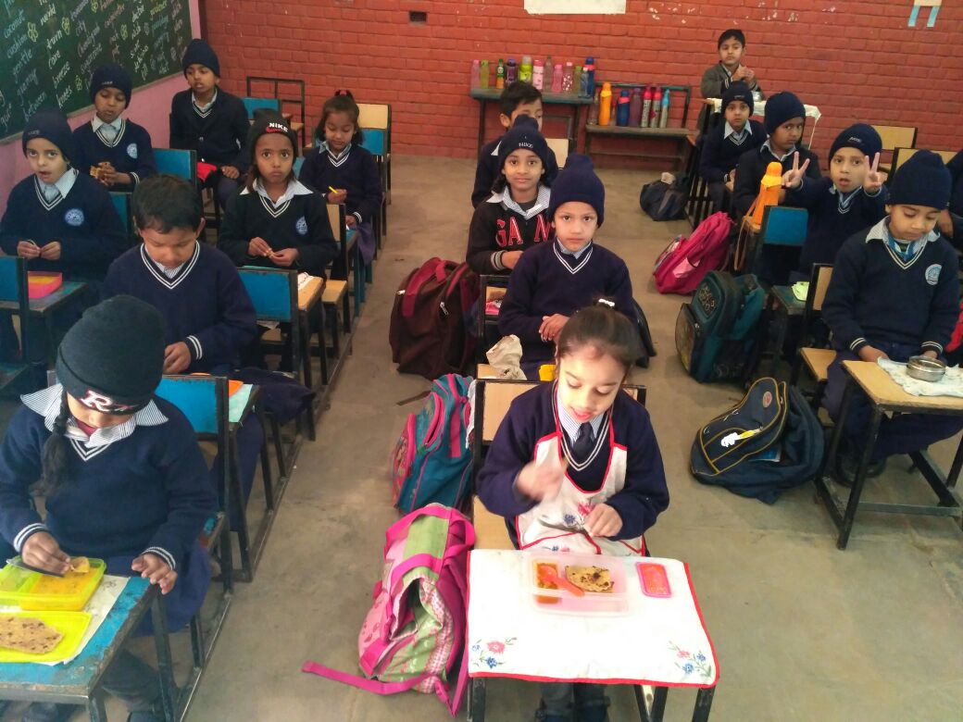
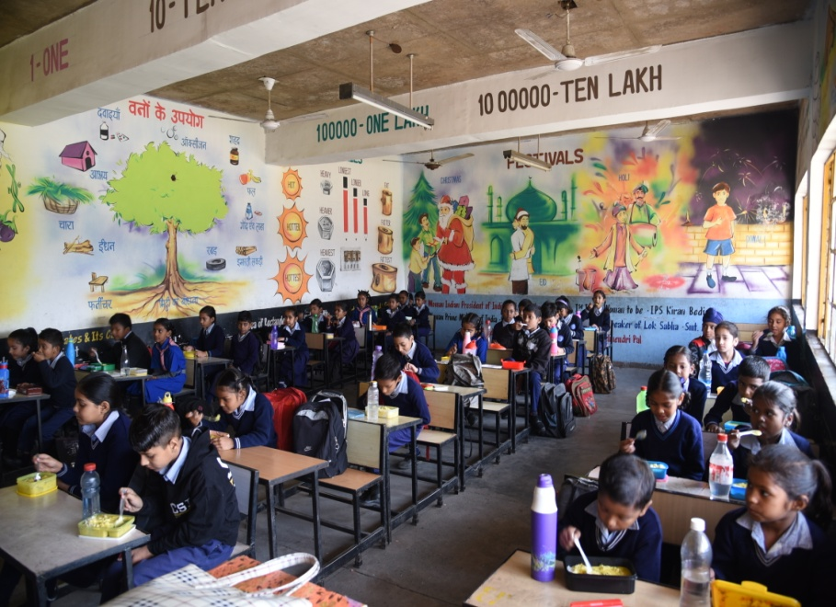
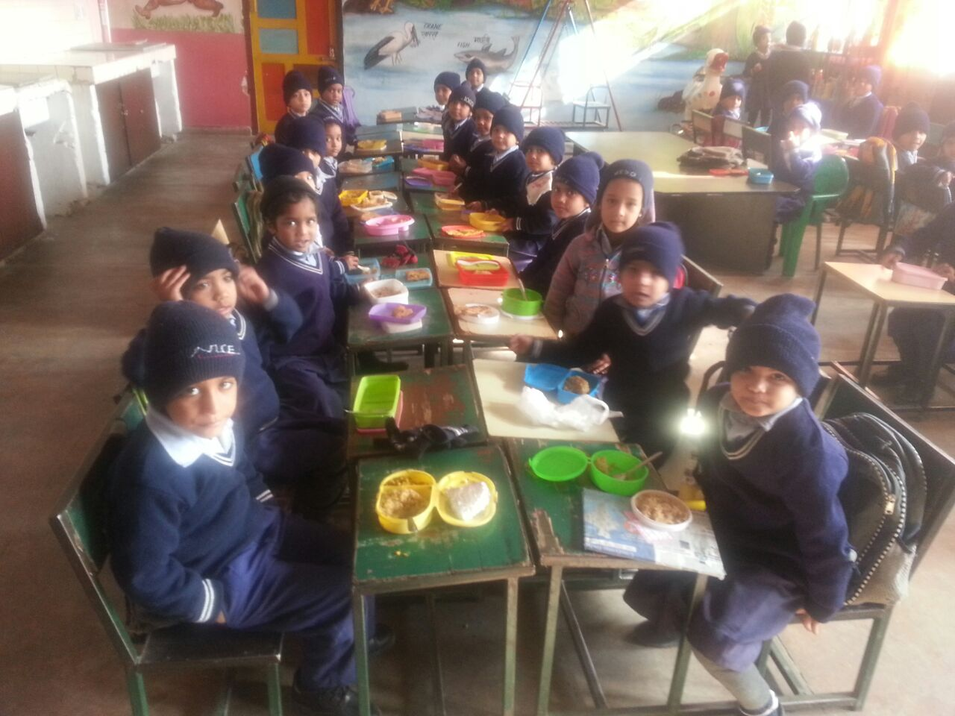
Distribution of meal in Schools

Slide 21
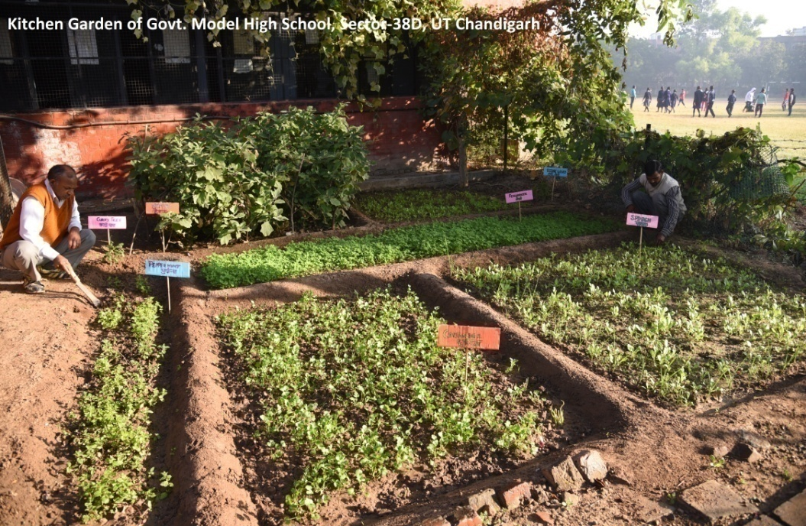
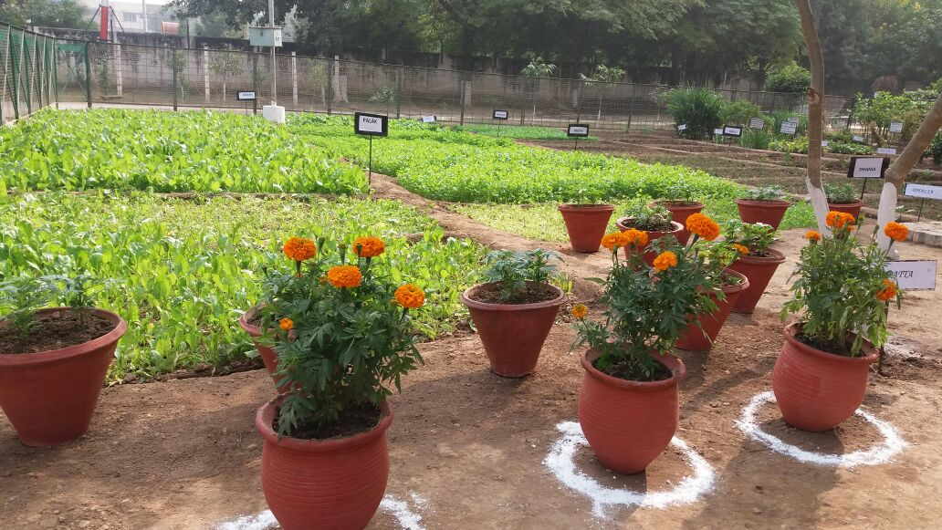
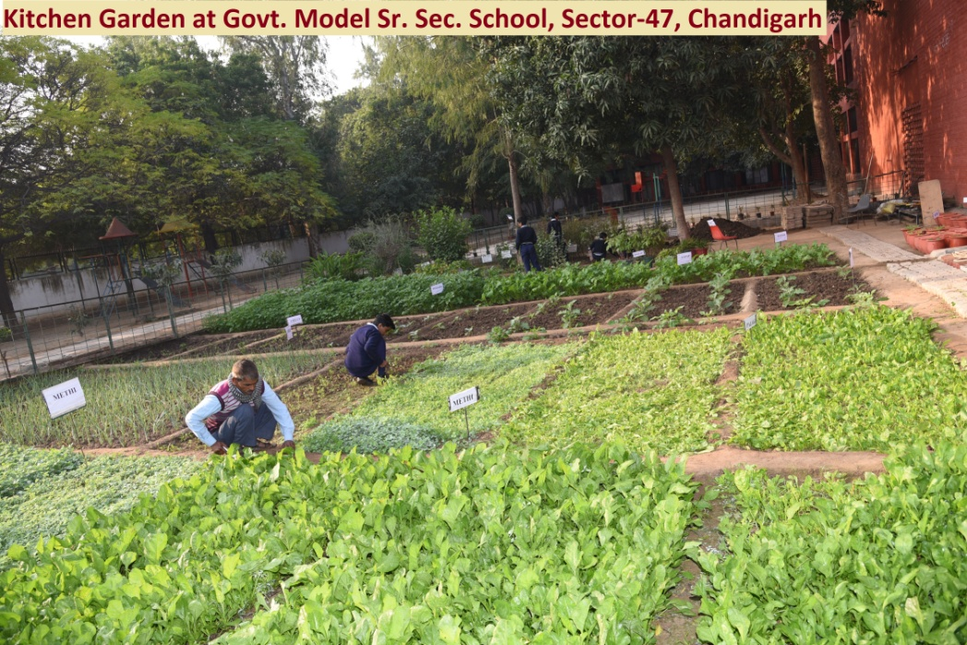
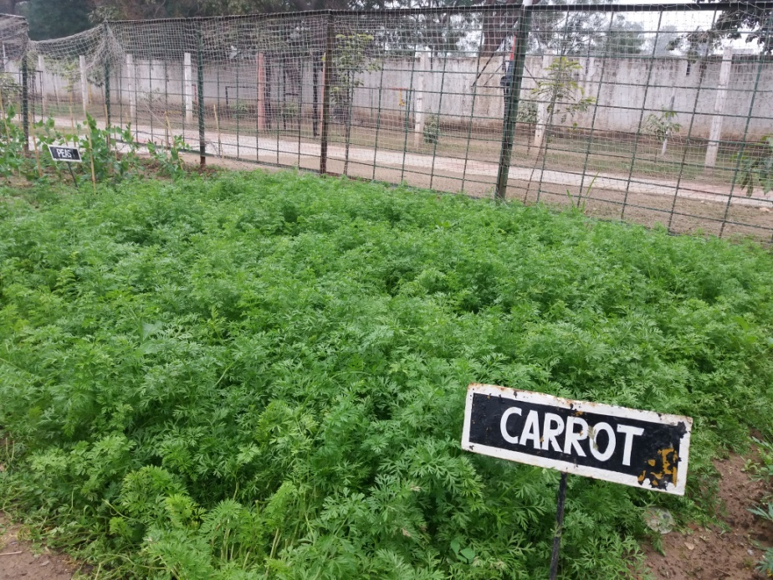
School Based Kitchen Gardening

Slide 22
Thanks

